Slide 1
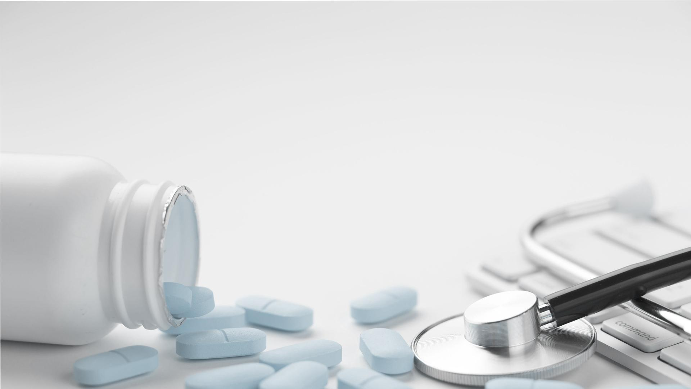
Kidney Rejection in Type 2 Diabetes Patients
Group 21 – John, Demitri, Sarah, Sherry and Lina

Slide 2

01
Contextual Background

Slide 3
Contextual Background
Nearly 1 Million Australian adults have Type 2 Diabetes and this number continues to increase (ABS, 2018).
Considering many individuals who undergo kidney transplant have Type 2 Diabetes, we were motivated to build our classifier for this subset of patients.
Diabetes injure blood vessels and with these injured blood vessels, kidneys cannot clean blood properly.
We were specifically interested in determining whether Type 2 Diabetes had a significant effect in predicting acute kidney rejection.
As such, between 10 to 40% of those with Type 2 Diabetes will suffer from kidney failure and will potentially need kidney transplant surgery (Marjan et al. 2012).
Due to the medical sensitivity of the app, we targeted the app towards medical professionals to use for patients with Type 2 Diabetes and Kidney disease.
Notes:
Add References (IN Bookmar)
As such, we aimed to build a prediction calculator to specifically examine kidney rejection in Type 2 Diabetes Patients.
In script make sure to say: we were motivated, target audience, contextual background etc.

Slide 4
02
Methodology

Slide 5

Type 2 Diabetes: GSE20966
Data Selection
Kidney Transplant: GSE14346
This dataset was used to train the diabetes classifier. It included more than 61 000 gene outputs for 20 patients. 10 patients in the dataset had Type 2 Diabetes and 10 did not.
This dataset was used to train the kidney rejection classifier. It included more than 54 000 genes for 75 patients. 38 patients had acute kidney reject and 37 had no rejection.

Slide 6
Data Process
1.
Pre processed data sets - normalising, filtering out NA’s.
2.
Filtered multiple probes by finding the maximum.(Kestler, H.)
3.
Filtered common genes present in both data sets.
4.
Filtered both datasets to top 10 genes with greatest significance.
5.
Trained and tested Random Forest Type 2 Diabetes Classifier.
6.
Labeled and subset the kidney dataset based on the Diabetes classifier.
7.
Trained and tested SVM Kidney Transplant classifier specifically for Type 2 Diabetes Patients.
Notes:
Found common genes - 4000?
3. Word better and and reference
4. Described this was tested and 10 genes did not decrease accuracy of model
5. Random Forest - explain chosen based on its strong accuracy in repeated test

Slide 7
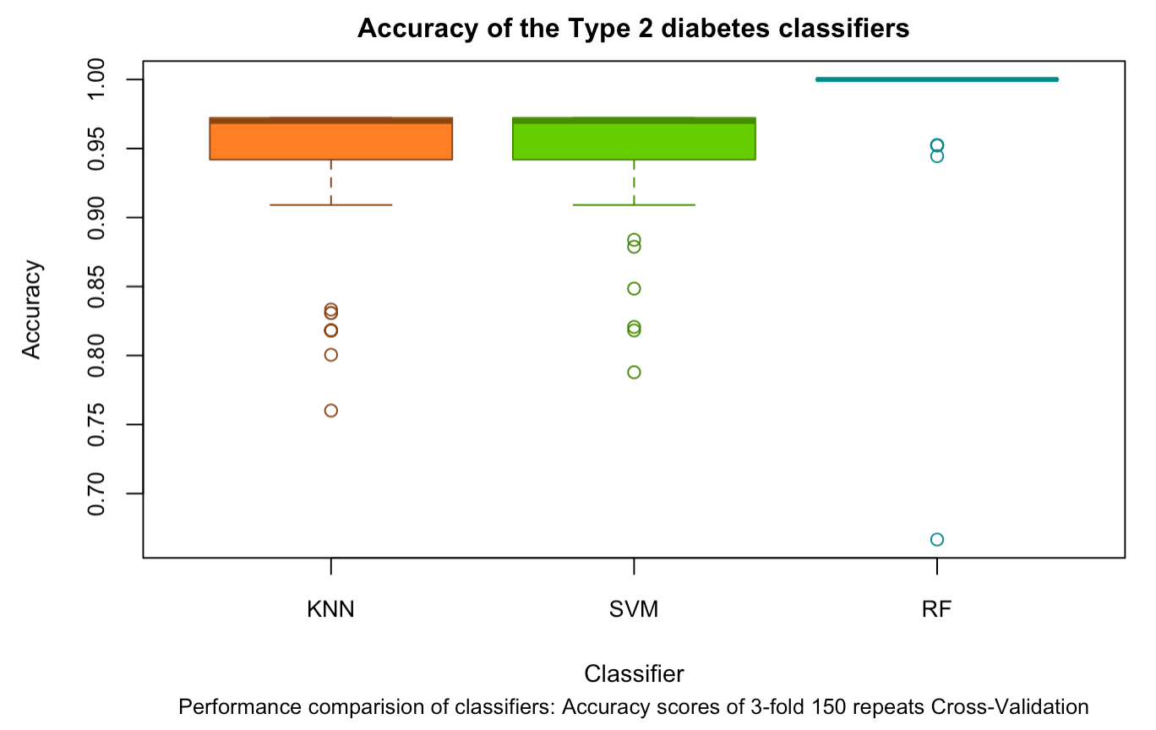
Random Forest
Type 2 Diabetes Classifier
Random Forest Classifiers predicts a result based on a number of single decision trees. (Yiu, 2019).
RF is commonly used in big data genomic studies.
For the diabetes dataset, RF was slightly more accurate, compared to KNN and SVM.
Notes:
https://towardsdatascience.com/understanding-random-forest-58381e0602d2

Slide 8
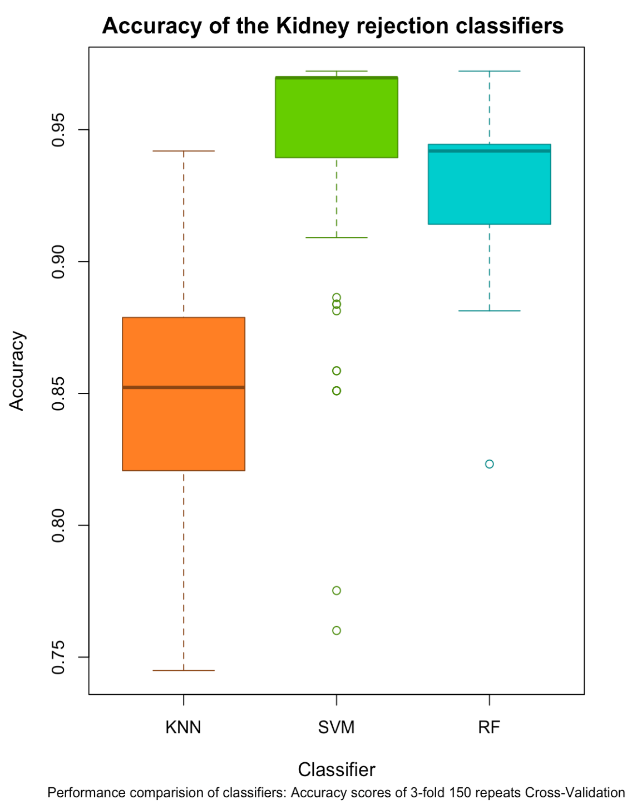
SVM
Kidney Rejection Classifier
Support Vector Machine Learning finds the best line of in a hyperplane through calculating the maximum margin (max distance between data points of both classes). (Gandhi, 2018).
SVM is also commonly used in big data genomic studies.
For the kidney rejection dataset, SVM was the most stablely accurate classifier, compared to KNN and RF.

Slide 9
03
Shiny App: Live Demonstration
Video Link: https://drive.google.com/open?id=1nGxGYaY2atakxAVbHCSp0ql7LFqvDrfU

Slide 10
04
Results

Slide 11
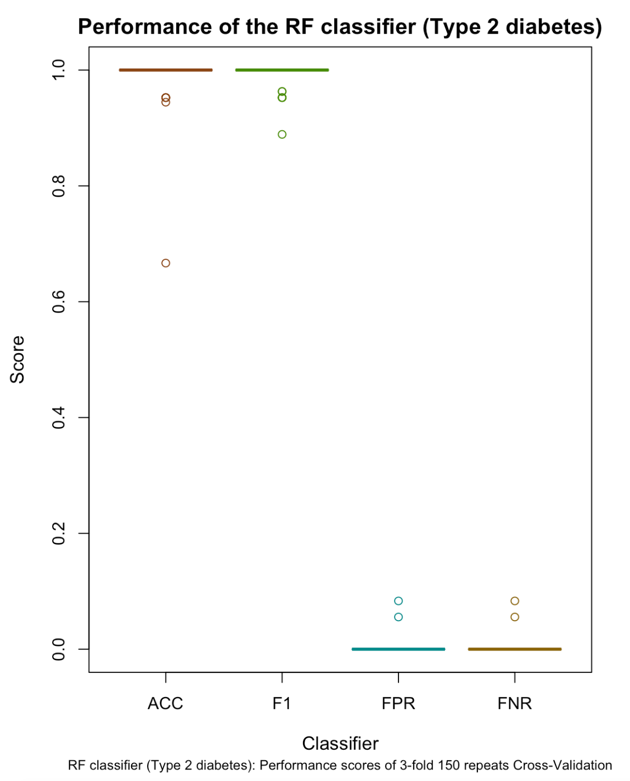
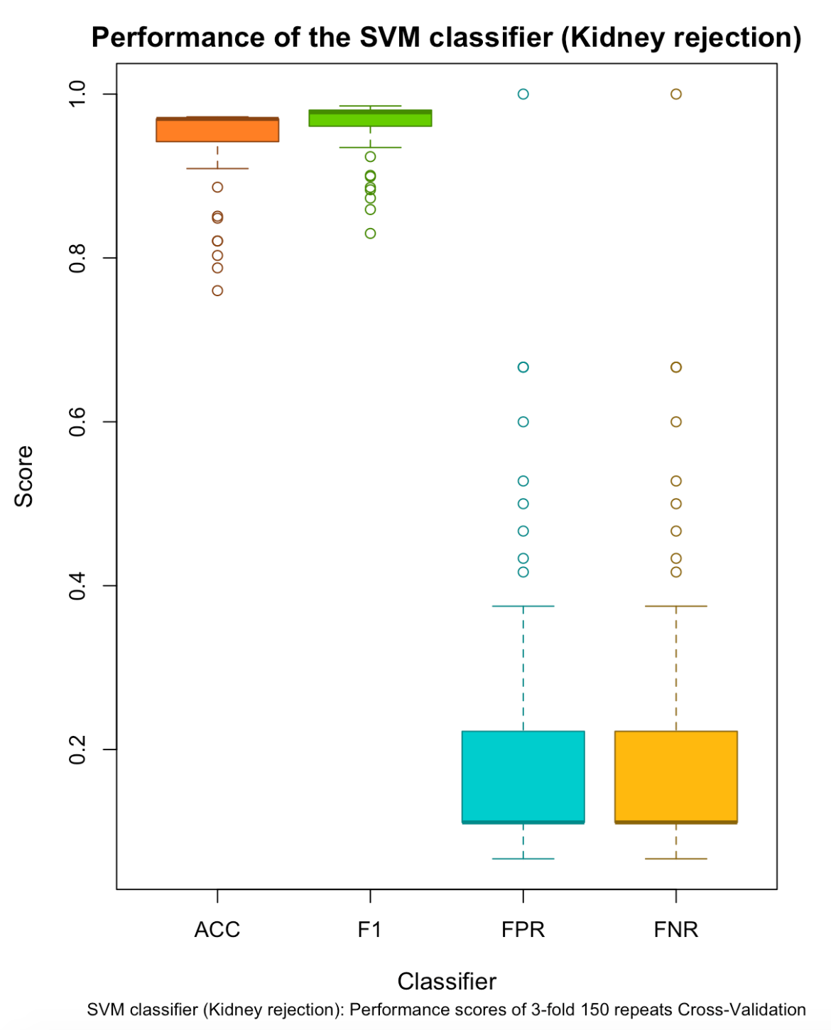
Classifier performance
Notes:
Speak about why FPR and FNR are important measures
Say the mean numbers

Slide 12
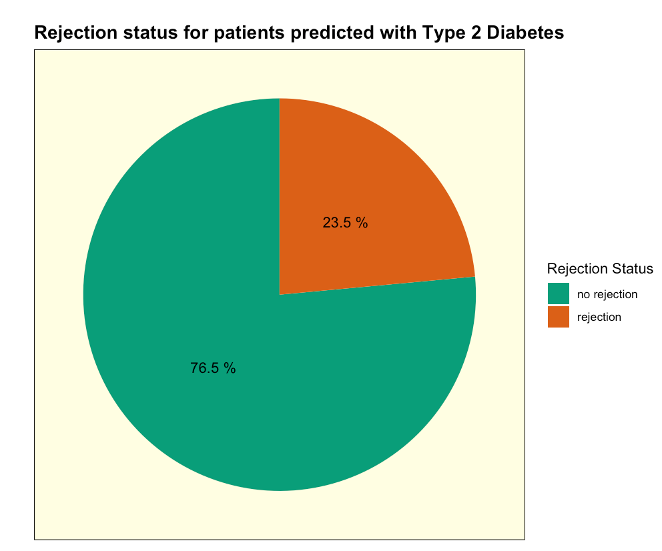
The classifier predicts 23.5% of patients with Type 2 Diabetes will experience kidney rejection.
According to Kidney Health Australia, for the general population of kidney transplants 6 % will have kidney rejection in the first twelve months (2019).
Based on our results therefore, individuals with Type 2 Diabetes have a higher chance of kidney rejection.

Slide 13
05
Limitations and Future Goals

Slide 14

Limitations
The Limitations of our Experiments
Limited sample sizes.
Running two classifiers lowers accuracy of results.
How do we deal with Multiple probes of the same Gene? Do we use the mean or maximum etc of the probes?
Validating our results, how do we know if we are correct?(Wet lab experiments such as Northern Blot, QPCR etc...)

Slide 15
Conclusions
Through this Shiny app we were able to predict Kidney transplant rejections specifically for Type 2 Diabetes patients.
Whilst gene expression is not clinically viable for predicting kidney rejection in 2020, we hope an app like this could be useful for future practitioners.
By uniquely targeting patients with Type 2 Diabetes and narrowing the target group, the results are more specific and targeted to an individual with kidney disease and Type 2 Diabetes.
The Type 2 Diabetes Kidney Rejection App could in the future have enormous benefits for the medical community in determining which individuals would benefit most from kidney transplant surgery.

Slide 16
References
Alssema, M., Newson, R. S., Bakker, S. J. L.,Stehouwer, C. D. A., Heymans, M. W., Nijpels, G., ... Dekker, J. M. (2012). One Risk Assessment Tool for Cardiovascular Disease, Type 2 Diabetes, and Chronic Kidney Disease. Diabetes Care, 35(4), 741-748. https://doi.org/10.2337/dc11-1417
Australian Institute of Health and Welfare. (2019). Diabetes. Retrieved from https://www.aihw.gov.au/reports/diabetes/diabetes
Australia, K. H. (2020).Kidney Transplant. Retrieved from https://kidney.org.au/your-kidneys/support/kidney-transplant
Kestler, H. (n.d.). mergeProbesForGenes. Retrieved
from RDocumentation: https://www.rdocumentation.org/packages/GiANT/versions/1.2/topics/mergeProbesForGenes
sapiens, H. (2010).Retrieved from Gene Expression Omnibus: https://www.ncbi.nlm.nih.gov/geo/query/acc.cgi?acc=GSE20966
sapiens, H. (2012).Retrieved from Gene Expression Omnibus: https://www.ncbi.nlm.nih.gov/geo/query/acc.cgi?acc=GSE14346
https://towardsdatascience.com/understanding-random-forest-58381e0602d2
https://towardsdatascience.com/support-vector-machine-introduction-to-machine-learning-algorithms-934a444fca47
Citation metadata

